Slide 1
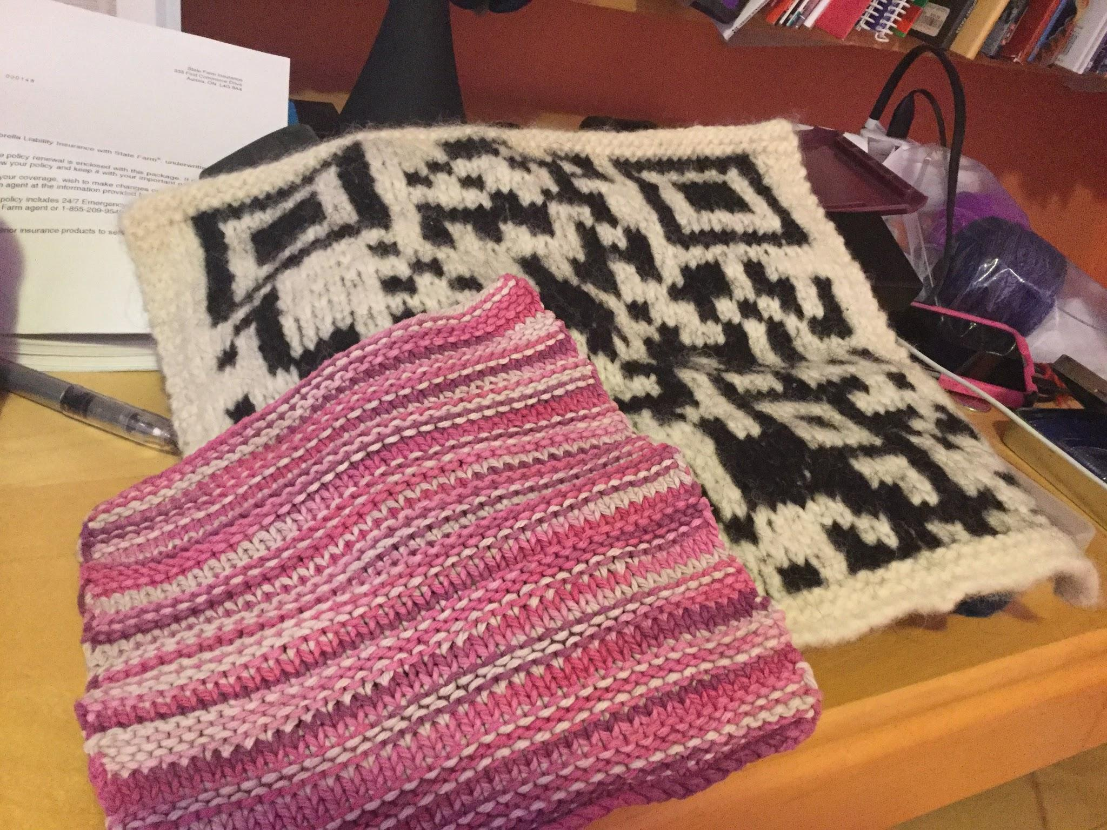
Dishcloths, Design Thinking and Knitted QR Codes - Oh My!
Prepared for #OLASC18
Lisa Noble @nobleknits2
lisa_noble@kprdsb.ca
bit.ly/dishola

Slide 2
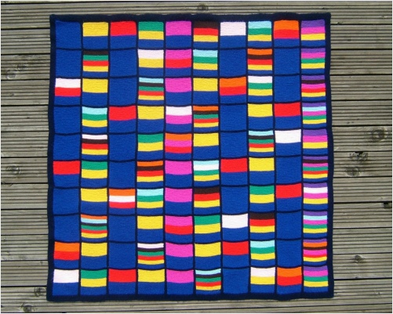
Notes:
That’s me, that’s us. - get a sense of where people are from, and why they’re there? Who knits? Who codes?
What do you notice, what do you wonder?

Slide 3
What do you notice, what do you wonder?
Tweet your answers to : @nobleknits2 on Twitter (use hashtag #olasc)
Or post them to this padlet: bit.ly/olablanket
Notes:
Take responses orally/run through Twitter - just to start the thinking juices happening. Make connections - point out items in the Flipboard - pi shawls, cellular automaton sweaters, increases, decreases, entrelac, mitred corners multi afghan

Slide 4
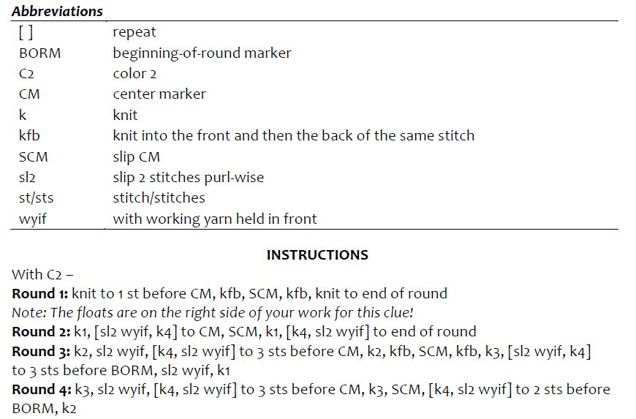
Notes:
Notice and wonder

Slide 5
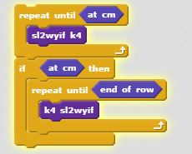
Round 2: k1 (sl2wyif, k4) to CM, SCM, k1, [k4,sl2wyif] to end of round

Slide 6
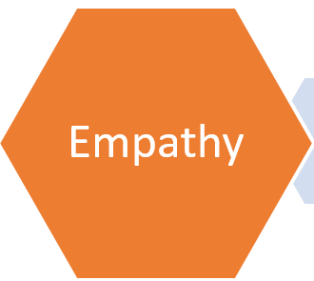
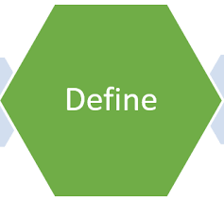
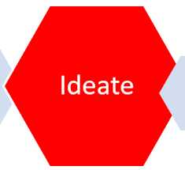
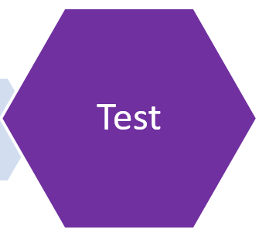
Notes:
Outline the elements of design thinking (back-up theory materials in Flipboard - great resources from Stanford) also #dtk12

Slide 7
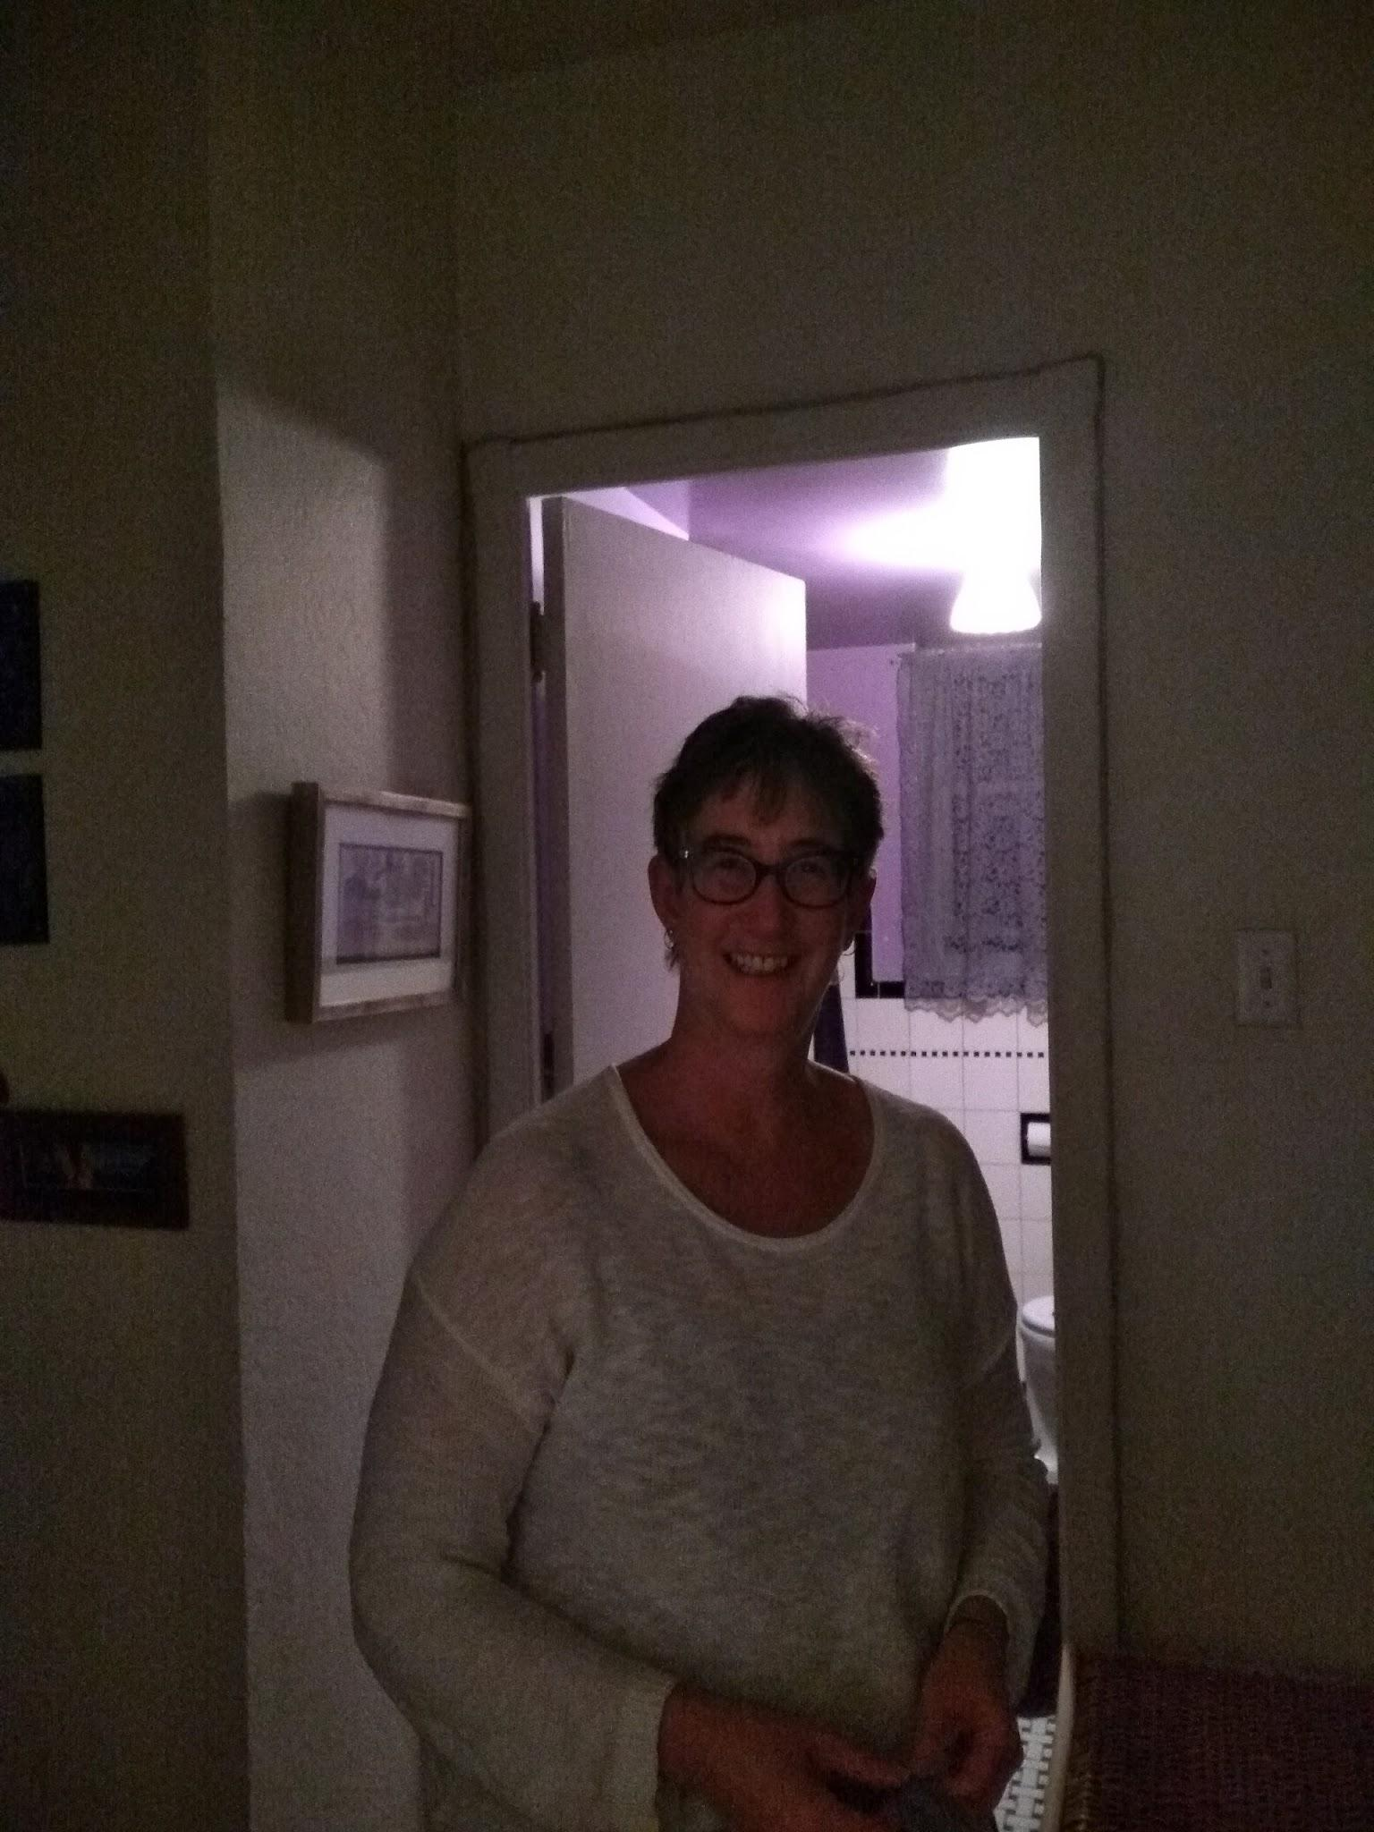
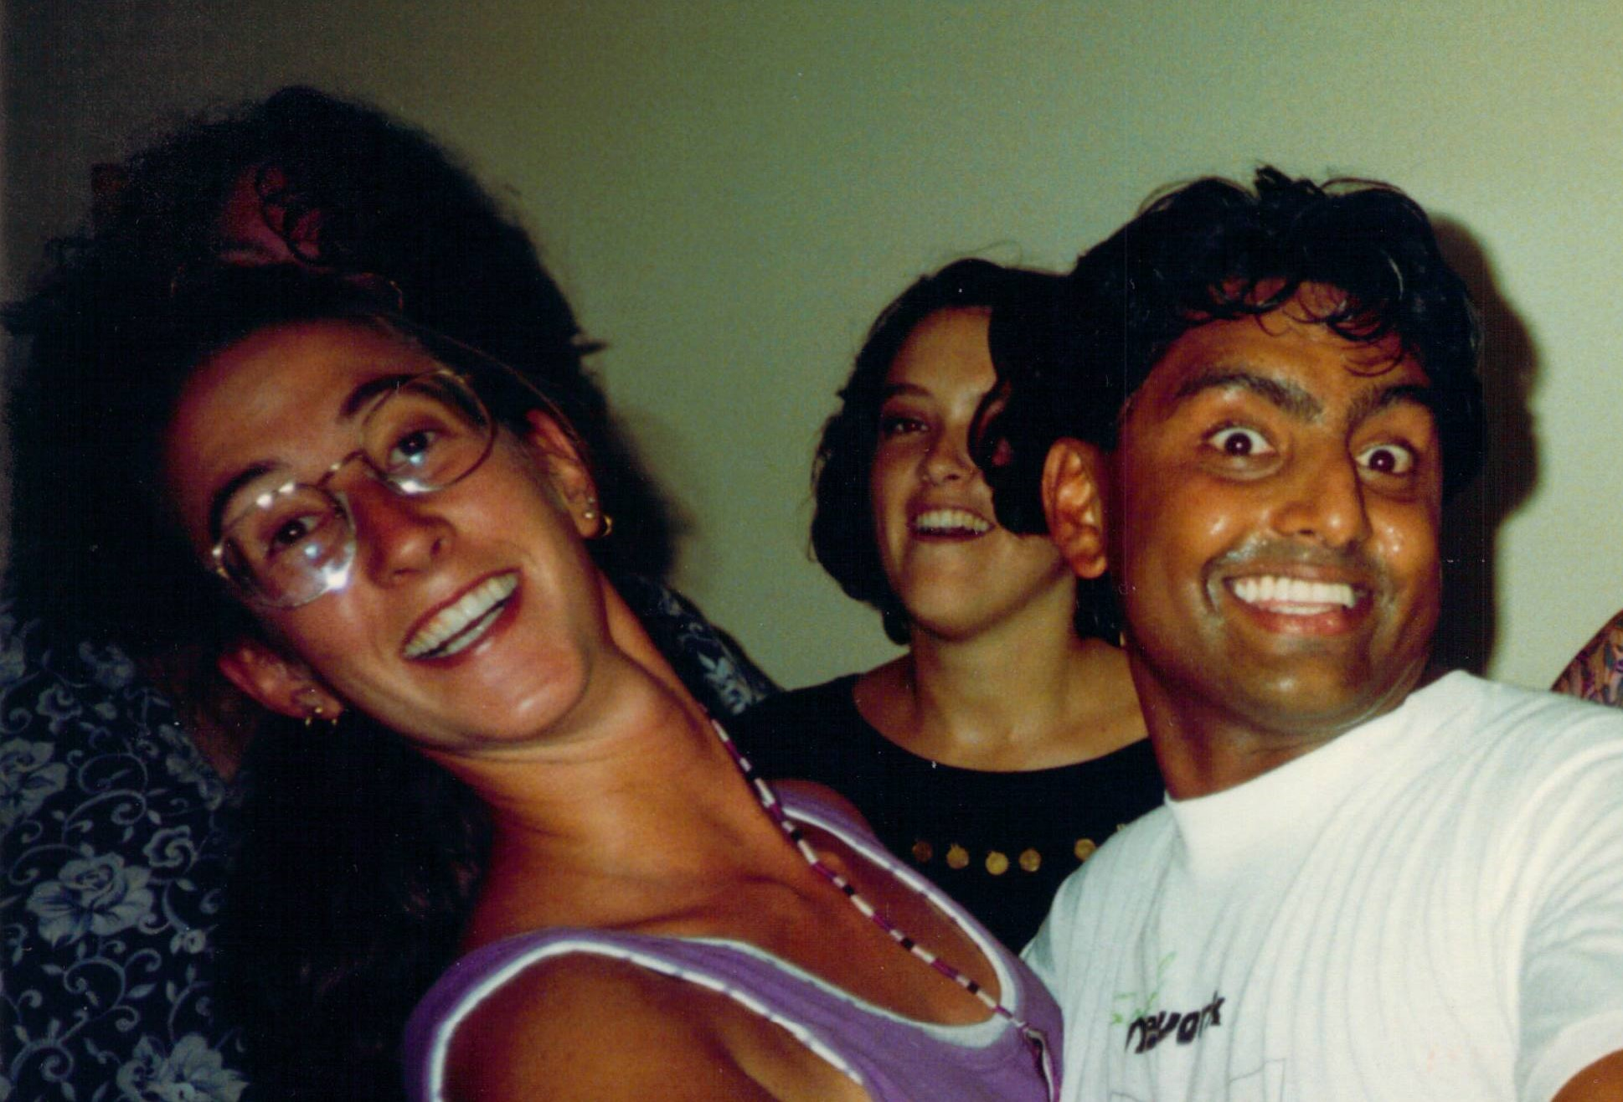
Notes:
Idea of design thinking: needs empathy, you create it with a specific audience in mind, introduce Cheryl.

Slide 8
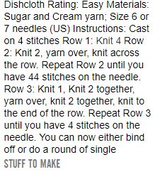
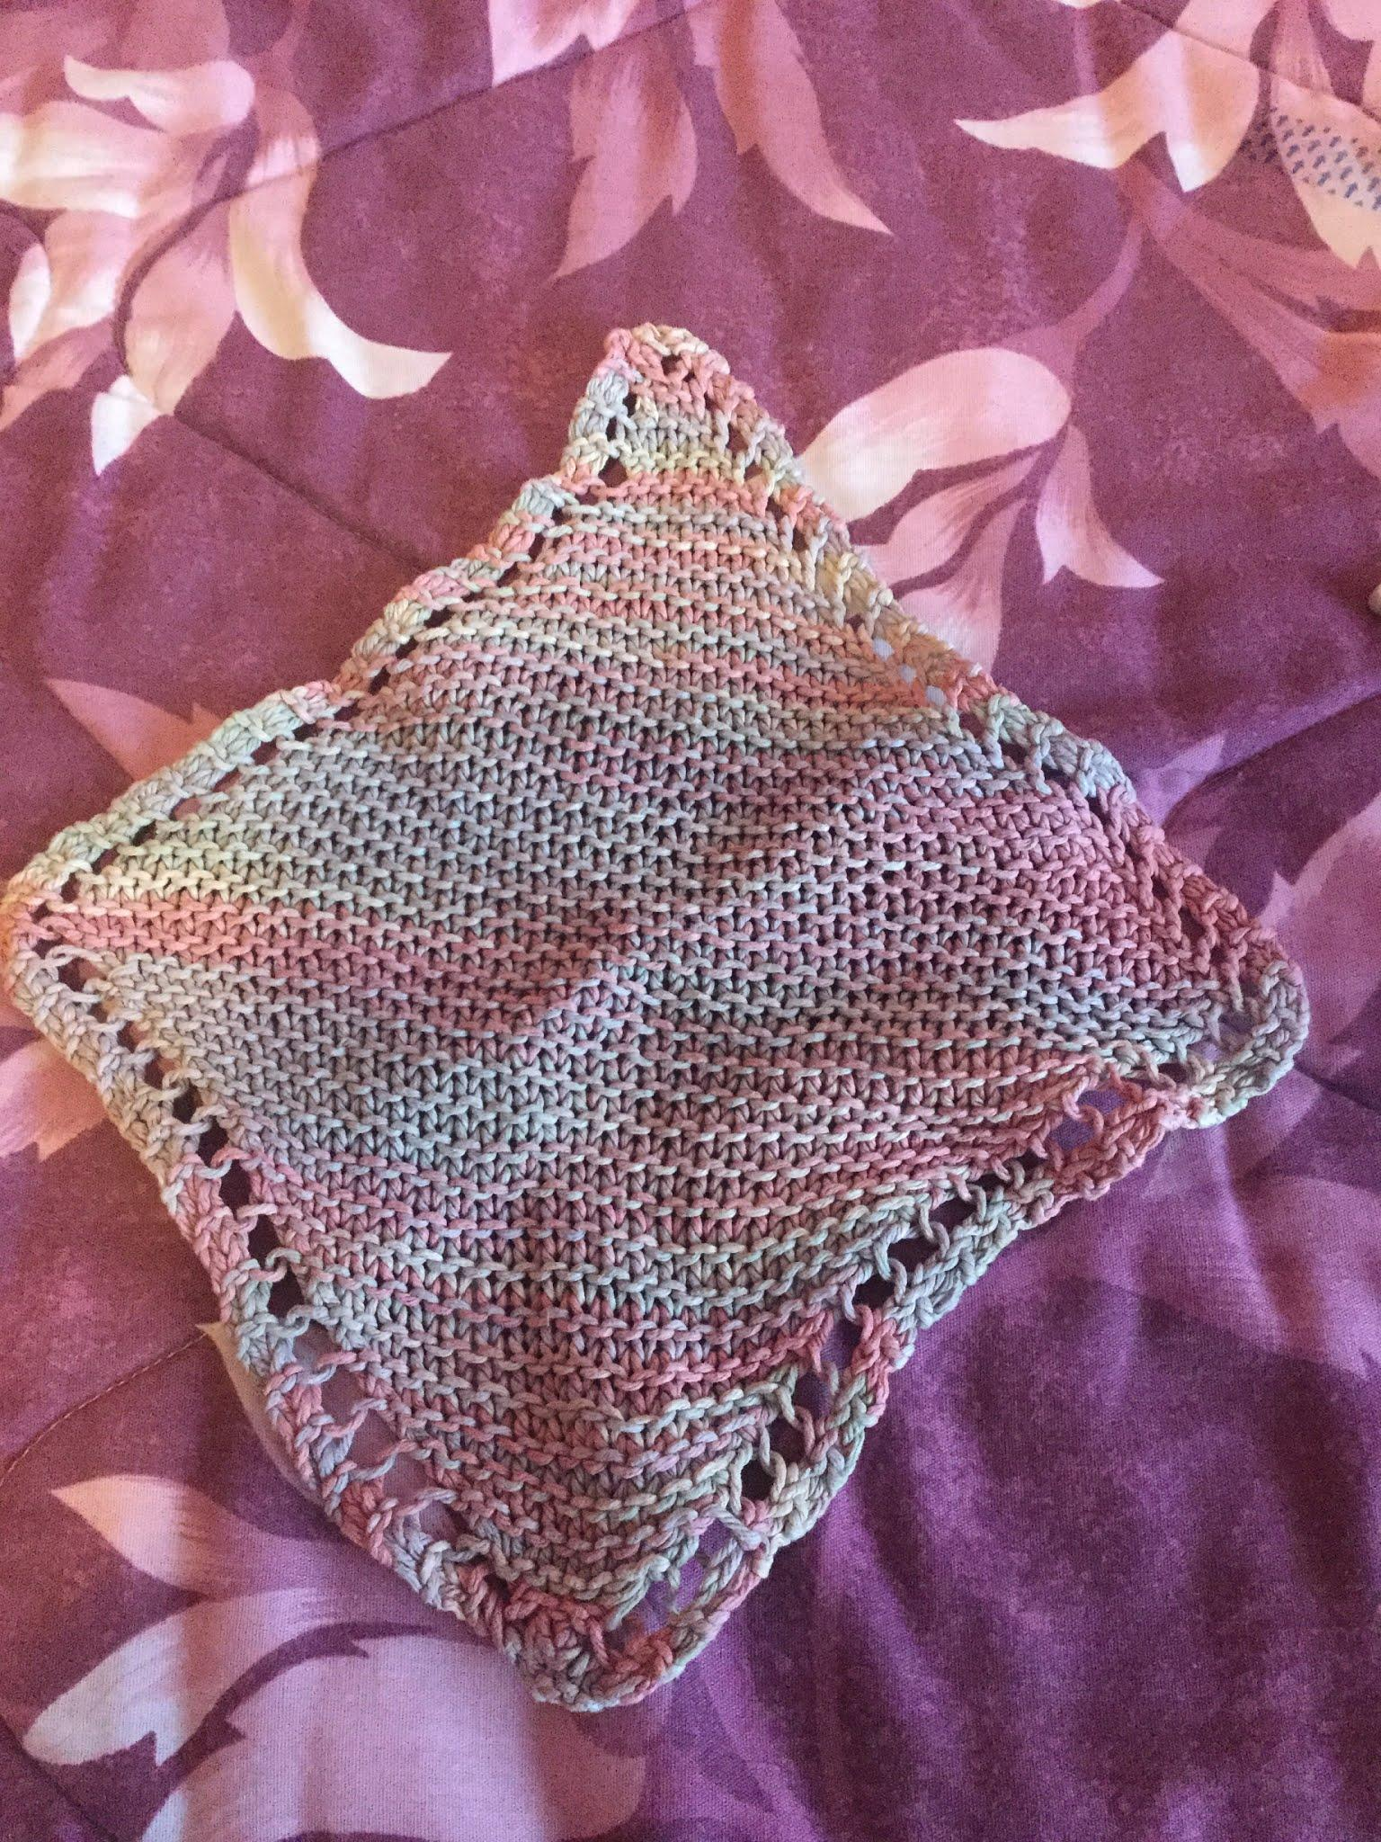
Notes:
The basic dishcloth (from the Bernat label) - trying to do it with beginners (crafting club) - everybody did the same one - pre-Ravelry. I knew we needed something better

Slide 9
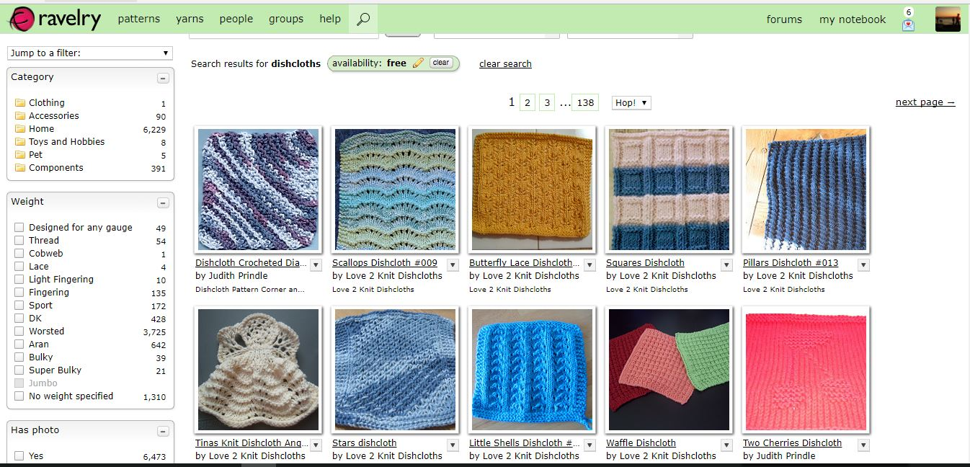
ravelry
Notes:
Once you have the basics of knit and purl, you can ideate: - design your own, share ideas with a friend, start with a pre-made pattern. A dishcloth provides a manageable sized canvas for beginning, but your students don’t have to stop there. Given them Graph paper and pencil crayons (pixelating) - minecrafters who have built favourite images in Minecraft are experts at this.

Slide 10
3 easy wash clothes pattern courtesy Elizabeth
Carls.
Notes:
My favourite go-tos - talk about iteration, that knitting is the ultimate iterative skill - don’’t like it, pull it out

Slide 11
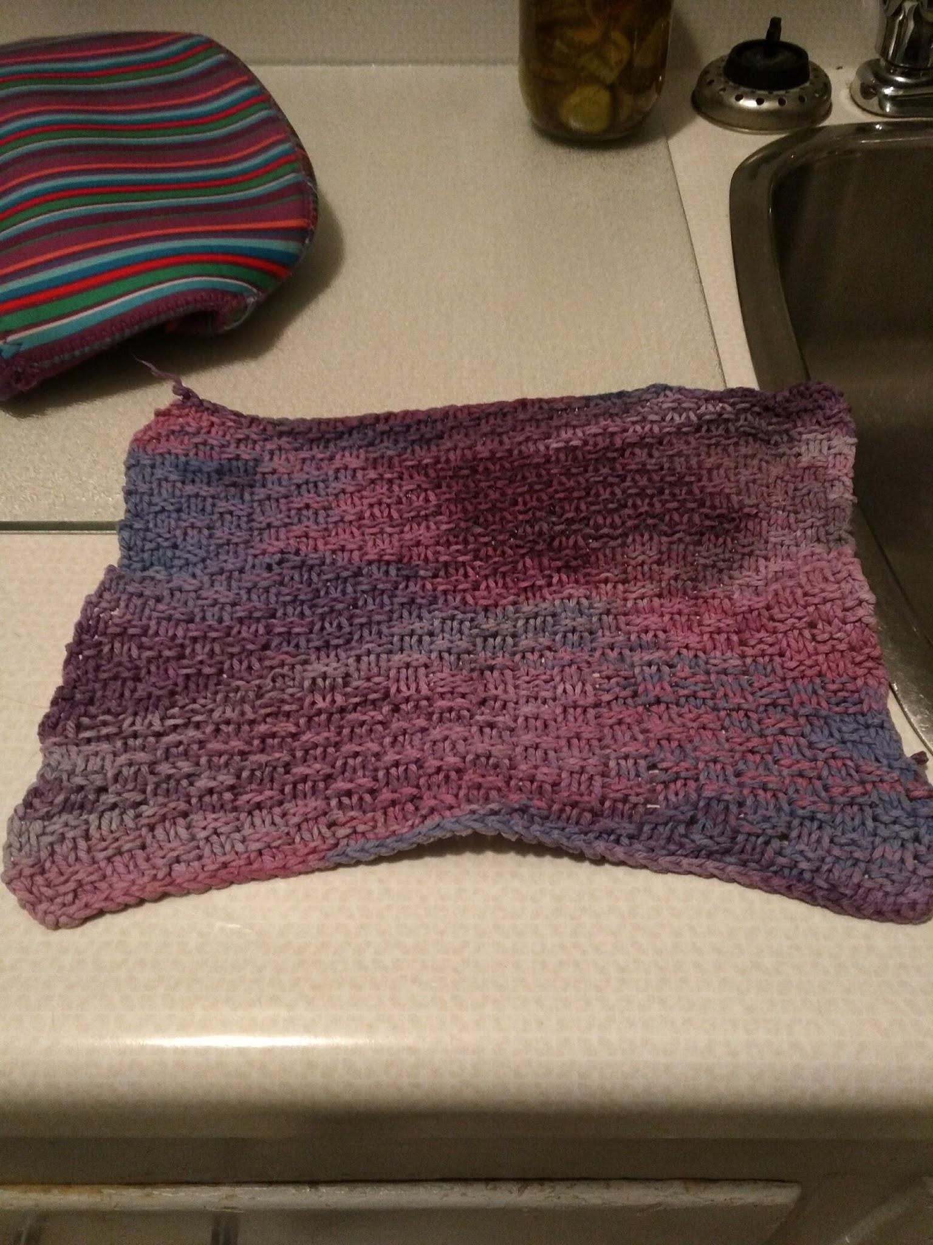

Slide 12
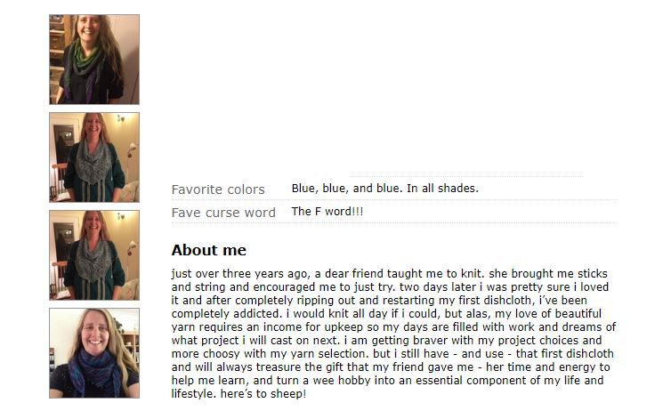
Where a dishcloth could lead you!

Slide 13
And onward:(and yes, you can knit a scannable QR code)
dishcloth and design flipboard
qr code flipboard
Ravelry
Knitty
techknitter index
qr code slide deck

Slide 14
And now: we knit!

Slide 15
Acknowledgements
Images: design thinking icons: wikimedia commons via cc
Knitted afghan: pat ashforth and steve plummer, woollythoughts.com
Yarn and needles: Anne Worner, flickr via cc
Thanks to everyone who donated needles and yarn (especially Knitomatic)

