Slide 1
Library and Archives Canada Update
Presentation to the Ontario Library Association (OLA) Super Conference
January 31, 2018

Slide 2
OCLC

Slide 3
OCLC Implementation & Milestones
Project implementation schedule was finalized in August 2017.
Phase | Description | Projected End Date
Phase 1 | National Union Catalogue data migrated to OCLC | September 2017
Phase 2 | National Union Catalogue launch | January 2018
Phase 3 | LAC begins using OCLC to manage its library acquisition functions | June 2018
Phase 4 | LAC Cataloguing and Circulation launch | October 2018
Phase 5 | AMICUS Decommissioning and Post Project Activities | May 2019

Slide 4
OCLC Implementation & Milestones
Online application form for small public and post-secondary libraries to register for LAC-funded OCLC services available from beginning of October to early December 2017.
LAC has received 76 applications for funding.
  Applications are being reviewed for eligibility.
  Eligible libraries will be notified and their information passed on to OCLC to do their required setup.
  Libraries who are not eligible will be notified and given information on the reasons.
  A second round of applications will begin next fiscal.

Slide 5
Strategy for a Digital Preservation Program
Notes:
Normand

Slide 6
Strategy for a Digital Preservation Program
The focal point of LAC’s strategy is to implement the strategic vision of digital preservation by:
  Implementing a sustainable technical infrastructure while securing LAC control over the critical path technology.
  Establishing a collections management framework to ensure that digital collections are systematically preserved.
  Producing evidence of program development, a key requirement for ISO 16363 certification.
  Designing and implementing the organizational framework for a program, while streamlining business processes.
  Securing adequate resources.

Slide 7
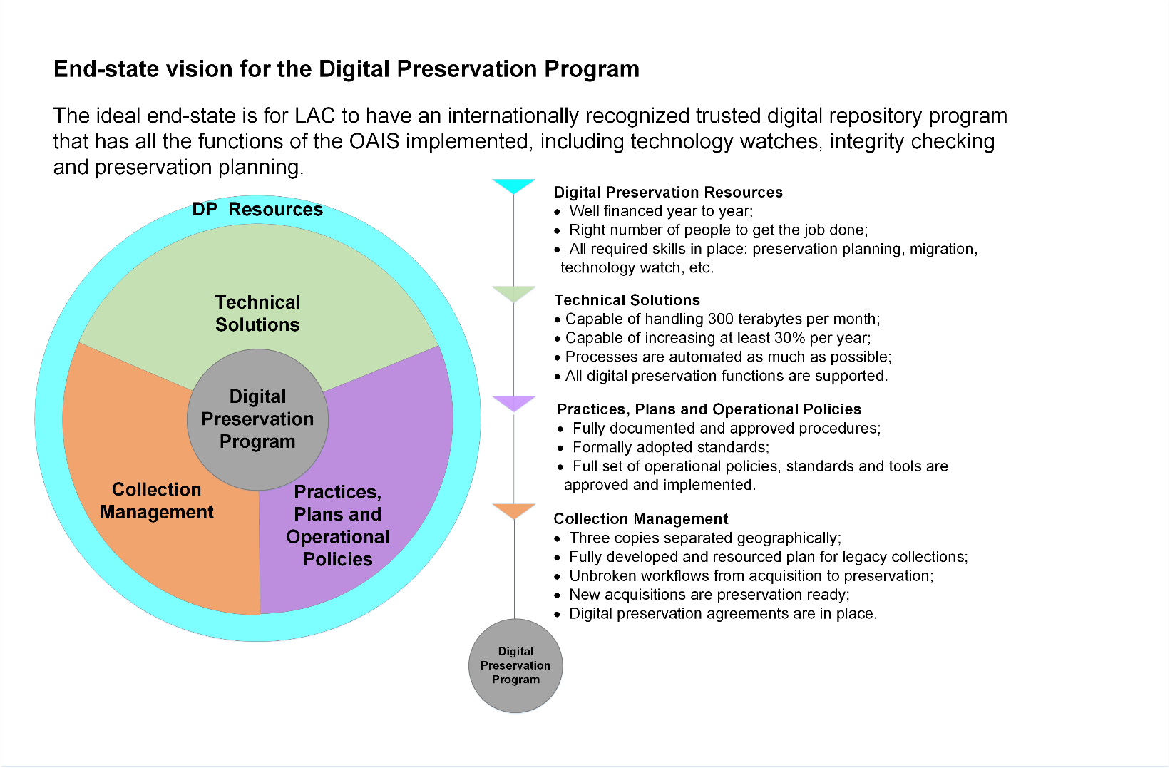
Strategy for a Digital Preservation Program

Slide 8
Digital Asset Management System (DAMS)

Slide 9
Digital Asset Management System
(DAMS)
The DAMS includes all processes, computer systems, software, and hardware that facilitate the process of digital asset management.
This includes, for example, processes and tools for:
  Bulk ingest of digital records
  Identification and migration of at-risk files
  Ingest and updating of metadata
  Full text search of digital records
Procurement of a modern DAMS is a key objective for LAC, as outlined in LAC’s long-term digital strategy (see LAC’s Digital Strategy 2015 and Beyond).

Slide 10
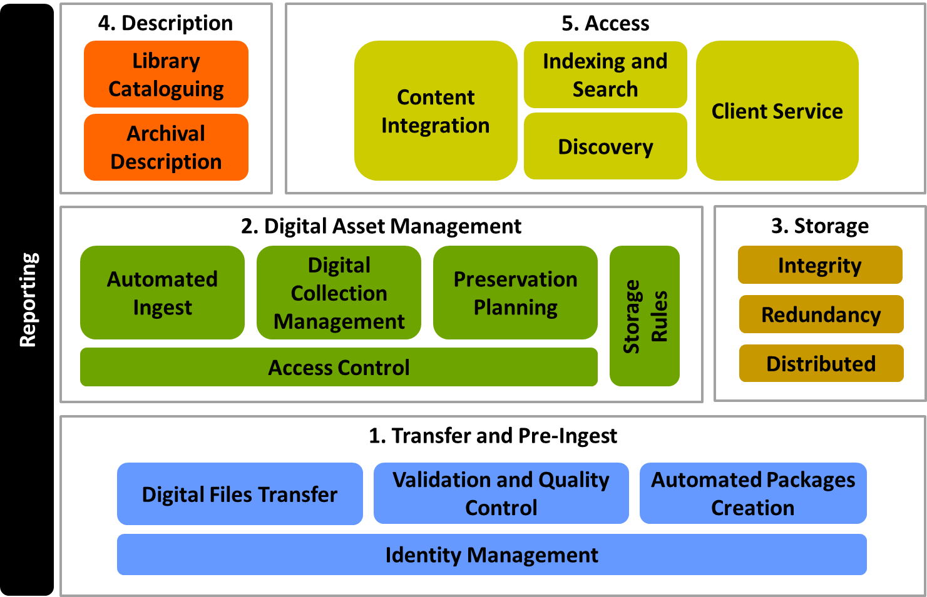
Digital Asset Management System (DAMS)
The DAMS exists within a framework of various systems at LAC.
For example, the DAMS will exchange information with LAC’s description systems for archival records (MIKAN) and published heritage (OCLC).

Slide 11
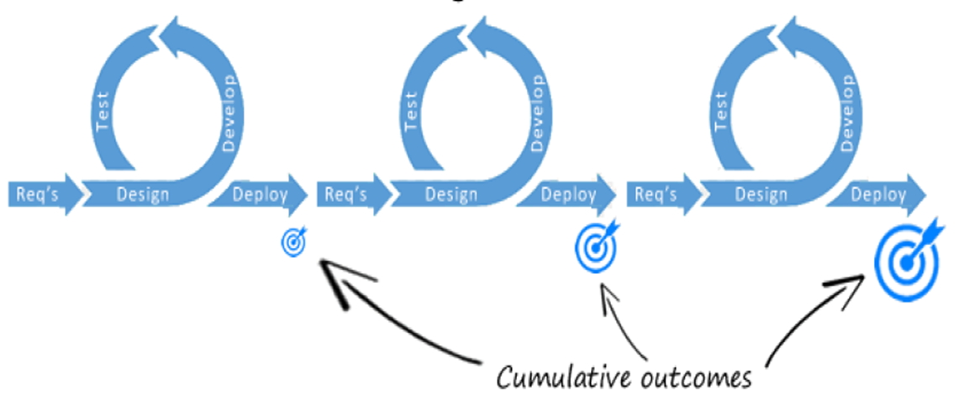
Digital Asset Management System (DAMS)
LAC is employing an agile approach to roll-out, starting with Legal Deposit and then expanding to other streams:
  e-theses
  Archival Government Records
  Other archival records
  Non-preserved material (backlog, born digital)
  Digitized analog material
  Migrated audiovisual material
  Public access (website, reprography, etc.)

Slide 12
Digital Asset Management System (DAMS)
Bidding Process
Acceptance Testing
Finalize
DAMS RFP
Evaluation
Implementation and Training
…
Apr | May | Jun | Jul | Aug | Sep | Oct | Nov | Dec | Jan | Feb | Mar | Apr | May | Jun | Jul | Aug | Sep | Oct | Nov | Dec | Jan | Feb | Mar | Apr
2017 |  |  |  |  |  |  |  |  | 2018 |  |  |  |  |  |  |  |  |  |  |  | 2019
Target for RFP
Contract Award
First priority is Legal Deposit, then other streams
Completed in 2016:
Industry meetings following the RFI
RFI Key Findings Report
Consultations (internal / external)
DAMS statement of requirements

Slide 13
Indigenous Language and Culture Revitalization Projects

Slide 14
Indigenous Language and Culture Revitalization
Digitization and Digital Access
Focus on LAC’s holdings that contain First Nations, Inuit and Métis-related content.
Material to be digitized may include historic photographs, audio-visual recordings, treaties, Indigenous language dictionaries and lexicons, correspondence from Indigenous leaders, material related to residential schools, portraits, early European journals/observations and cartographic material.
Creation of new and improved means of digital access including digital finding aids, online research guides and databases, and online engagement and learning tools.
Audio Recordings
Support to Indigenous communities in their efforts to preserve and revitalize traditional languages in Métis, First-Nations and Inuit languages.
Creation of a dynamic web portal where audio recordings made in Métis, First-Nations and Inuit languages can be digitized, preserved, transcribed, translated and accessible.
Portal will mix spoken word recordings in all expressions: songs, storytelling, poetry, language training exercises, and more.
Creators of the recordings will remain their sole owners.

Slide 15
Implementation of the Initiatives to Date
Meetings with the 3 organizations (Métis National Council, Assembly of First Nations, Inuit Tapiriit Kanatami): presentation of the initiatives and consultation on the Advisory Circle.
First meeting of the Advisory Circle planned for February 2018.
Staffing processes:
  Hiring of archivists from Indigenous communities who will work in regions.
  Hiring of the Advisor for Indigenous Engagement and Partnerships.
Digitization of Indigenous-related documentary heritage has started.
Indigenous Cultures Awareness and Learning Program for LAC employees (answer to the Call to Action #57).

Slide 16

Gatineau 2 Project

Slide 17
Project Update
On October 31, 2017, LAC announced the launch of a procurement process for the construction of a new Preservation Centre in Gatineau, Quebec.
  The project includes the construction of a state‑of‑the‑art preservation facility and the optimization of the vaults in its current Preservation Centre.
  The new facility will be located just behind, and will be linked to, the existing Preservation Centre.
  The location of the new facility was purchased in 1989 by the Government of Canada on behalf of the National Archives of Canada (now LAC).
  The new facility will mainly store textual archival records.

Slide 18
Next Steps
Continue the procurement process.
  Request for Qualifications:
    January 4, 2018 was the deadline to submit proposals.
    Three consortia submitted proposals
    March 2018: Notification of the results of the qualification process
  Request for Proposal (RFP):
    Spring 2018: Launch of the RFP.
Construction is expected to begin in 2019 and should be completed in 2021.

Slide 19
Ottawa Declaration Working Group

Slide 20
The Ottawa Declaration (2016)
“We commit to adapt and reinvent our institutions and to collaborate to promote the full value of GLAMs to Canadians.
We shall:
Increase collaboration between our institutions to catalyse new partnerships that spark creativity and enhance engagement
Develop innovative programs and services to empower us to engage our publics
Enrich and expand access to our collections to ensure we contribute significantly to the public good and sustainable development.”

Slide 21
The Ottawa Declaration Working Group
Co-chaired by Dr. Guy Berthiaume and John McAvity, Executive Director of the Canadian Museums Association.
Composed of 6 members with expertise from across the GLAM sector.
Three-year mandate for implementing the visions contained in the Ottawa Declaration.

Slide 22
Key activities: 2017-2018
  Hosted the 2018 Summit on GLAMs: “Taking it to the Next Level” on January 30, 2018, at the ROM. 360 registrations.
  - 4 pillars for Summit: communities, Indigenous, private sector, government priorities
  Completed a preliminary environmental scan of cultural policies in Canada, France, Italy, Spain and UK.
  Scoping a study on the value of GLAMs in Canada (in progress).
  Is taking an active role in identifying areas where partnerships could be developed within the GLAM community, with the aim of developing creative and collaborative initiatives to engage with the Canadian public (building on CUCL survey).

Slide 23
IFLA Global Vision Discussion 2018

Slide 24
2017-2018: Creating a Global Vision
On April 4-5, 2017, IFLA launched the Global Vision Discussion in Athens, Greece, to explore how libraries can meet the challenges of the future.
A series of 6 regional meetings was held (North America, Africa, Middle East, Latin America and the Caribbean, Asia Oceania and Europe)
  In North America, the meeting was held at the Library of Congress in Washington, D.C. on May 3, 2017.
IFLA encouraged its members to organize their own discussions.

Slide 25
Global Vision Discussion at LAC
On June 22, 2017, LAC hosted its own Global Vision Discussion of LAC stakeholders and staff in the National Capital Region.
Approximately 50 people participated, including representatives from library, research, historical and museum associations; universities; and archival and library councils.
Keynote speaker: Leslie Weir, President of the Ontario Library Association.

Slide 26
2018-2019: Creating Action Plans
A final Global Vision Report will be published by IFLA at the IFLA President’s Meeting in Barcelona, Spain, on March 19-21, 2018.
Based on the report, concrete action plans will be developed over the course of the following year.
  Six regional workshops planned (March to July 2018)
    North America regional workshop: at LAC (16-17 or 17-18 April 2018)
Final action plans are expected to be presented in March 2019.

Slide 27
Canadian National Heritage Digitization Strategy

Slide 28
Canadian National Heritage Digitization Strategy
(NHDS)
Since Spring 2017:
  NHDS joined consortium on rights statements (RightsStatements.org) led by the Digital Public Library of America (DPLA) and Europeana.
  Request for interest launched – 50 GLAMs pledge to participate in NHDS.
  $1.1M from private donors received.
  Seven Steering Committee meetings held; minutes available on website (https://nhds.ca/)
  Progress made on foundational projects:
    Newspaper pilot – Consultation ended. Digitization of Indigenous newspaper titles under way.
    Standards building – National standards identified and common data model drafted.
    Discovery platform – Prototype developed.
    Content strategy – Document drafted to identify shared principles and starting point.
Notes:
Donations received from: HBC and Salamander Foundation. Bulk of the donation came from anonymous donor.
Collaborated with Indigenous newspaper publishers to get permission. Titles are from LAC collection and include:
Windspeaker –Widely circulated Indigenous news publication. Biweekly
Turtle Island News – National native weekly
Ha Shilth Sa –Oldest first nations newspaper

Slide 29
Canadian National Heritage Digitization Strategy
(NHDS)
Next steps (Winter/Spring 2018):
  In-person meeting of Steering Committee on January 31, 2018.
  Funding stream to be announced to support digitization.
  Campaign to build awareness and involve more communities.
  Further funding opportunities to be explored.
  Further progress to be made on foundational work:
    Newspaper pilot – Digitized Indigenous newspaper titles to be posted online.
    Standards building – Draft standards to be shared with public for comment.
    Discovery platform – Prototype to be shared for testing.
    Priorities – Community to be surveyed to identify projects.
    Content strategy – Feedback from public to be sought.

Slide 30
Steering Committee on
Canada’s Archives

Slide 31
Steering Committee on Canada’s Archives

Slide 32
Archival Workforce Taskforce
Co-Leads: Kathryn Harvey, University of Guelph and Jeanne Darche, Institut national de la recherche scientifique (INRS)
The Archival Workforce Taskforce’s mandate is to gain a better understanding of the current and future state and composition of the Canadian archival workforce.
The Taskforce intends to explore linkages between archival education programs offered by colleges and universities, on the one hand, and assess the issues and challenges experienced by workplace practitioners on the other hand.

Slide 33
Awareness Strategy Taskforce
Co-Leads: Heather Gordon, City of Vancouver and Jacinthe Duval, Bibliothèque et Archives nationales du Québec, (BAnQ)
The Awareness Taskforce has two interrelated project goals: Create a National Advocacy Strategy and a National Public Awareness Strategy.
In order to raise the profile of archives in Canada, the archival community must be equipped with the necessary tools and resources to coordinate messaging, increase engagement, and develop productive partnerships, with elected officials, community allies, private industry, academic institutions, and the general public.

Slide 34
Response to the Report of the Truth and Reconciliation Commission Taskforce
Co-Leads: Erica Hernández-Read (University of Northern British Columbia)
The Taskforce mandate is to conduct a review of archival policies and best practices existent across the country and identify potential barriers to reconciliation efforts between the Canadian archival community and Indigenous record keepers.

Slide 35
Get Involved
The Archival Workforce Taskforce and the Response to the Report of the Truth and Reconciliation Commission Taskforce are seeking new members.
To get involved, please contact the SCCA Co-Chairs:
  Luciana Duranti, luciana.duranti@ubc.ca
  Cédric Champagne, champagne.cedric@uqam.ca

