Slide 1

Turning Outward to
Your Community
How are you doing and why it matters
Cheryl Gorman and Susan Taylor Simpson, Presenters, The Harwood Institute for Public Innovation
Wendy Newman, Convenor, Faculty of Information, University of Toronto (Retired)
OLA Superconference – Thursday February 1, 2018

Slide 2
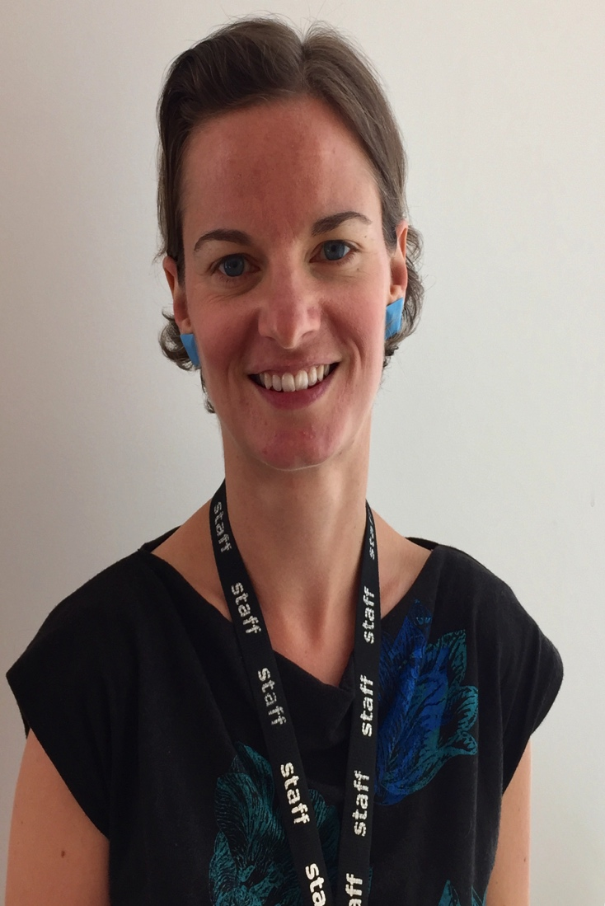
Cara Pryor
Head of Community, Program and Service Development (Retired) North Vancouver City Library
“This process pushed us to think beyond programs ...It has created profound changes in the way we approach our work in community – and we KNOW that it matters.

Slide 3
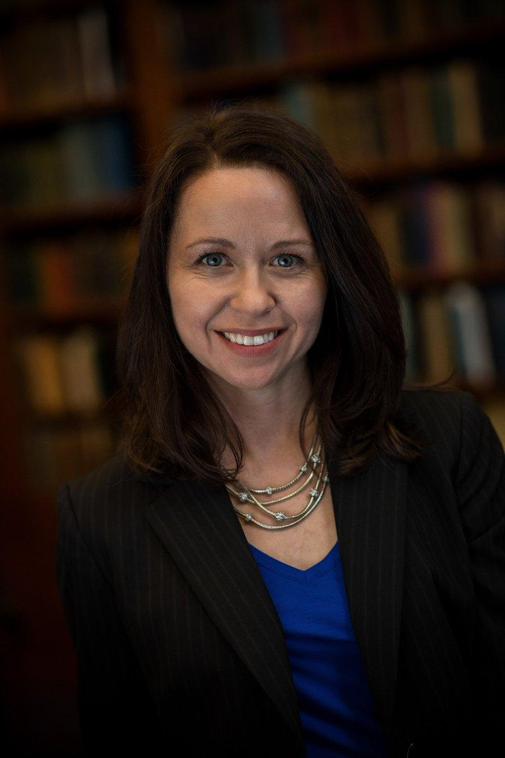
Heidi Daniel
President and CEO, The Enoch Pratt Library, Baltimore, Maryland
"By understanding our community, we can collaborate to solve problems and bring about positive change."

Slide 4
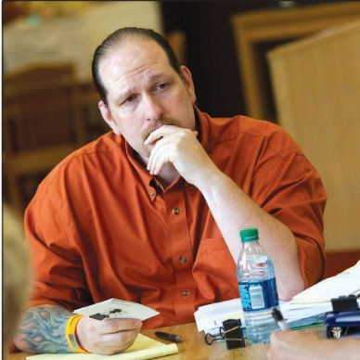
Brian Dawson
Library Development Director, State Library Department of Education, Pennsylvania
"It's the pragmatic approach, not Utopian. You learn to set real expectations for your community."

Slide 5
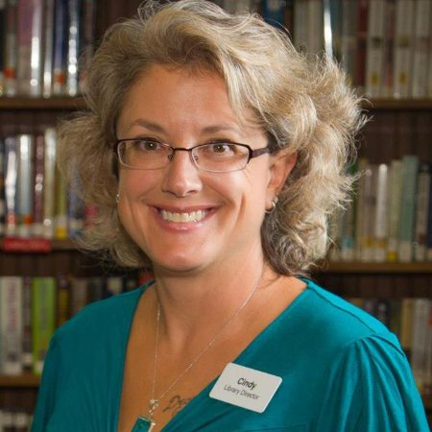
Cindy Fesemyer
Director, Columbus Public Library, Madison, Wisconsin
"We can be what people need. It's common sense, but sometimes you have to teach common sense."

