Slide 1

Turning Outward to
Your Community
How are you doing and why it matters
Cheryl Gorman and Susan Taylor Simpson,
Presenters, The Harwood Institute for Public Innovation
Wendy Newman, Convenor, Faculty of Information, University of Toronto (Retired)
OLA Superconference – Thursday February 1, 2018

Slide 2
AGENDA
Your community engagement experience
Harwood overview + why libraries
How to get the most out of this session
Turn Quiz exercise
  Experience
  Benefits and how to use at home
Other opportunities

Slide 3
I would describe our library’s community engagement as:
Just getting started; moving beyond outreach
Off to a good start and actively exploring
Part of how we work now
Well established; refining our skills

Slide 4
Harwood Mission
The Harwood Institute for Public Innovation is a nonpartisan, independent nonprofit that teaches, coaches and inspires people and organizations to solve pressing problems and change how communities work together.

Slide 5

Libraries Matter!
5

Slide 6
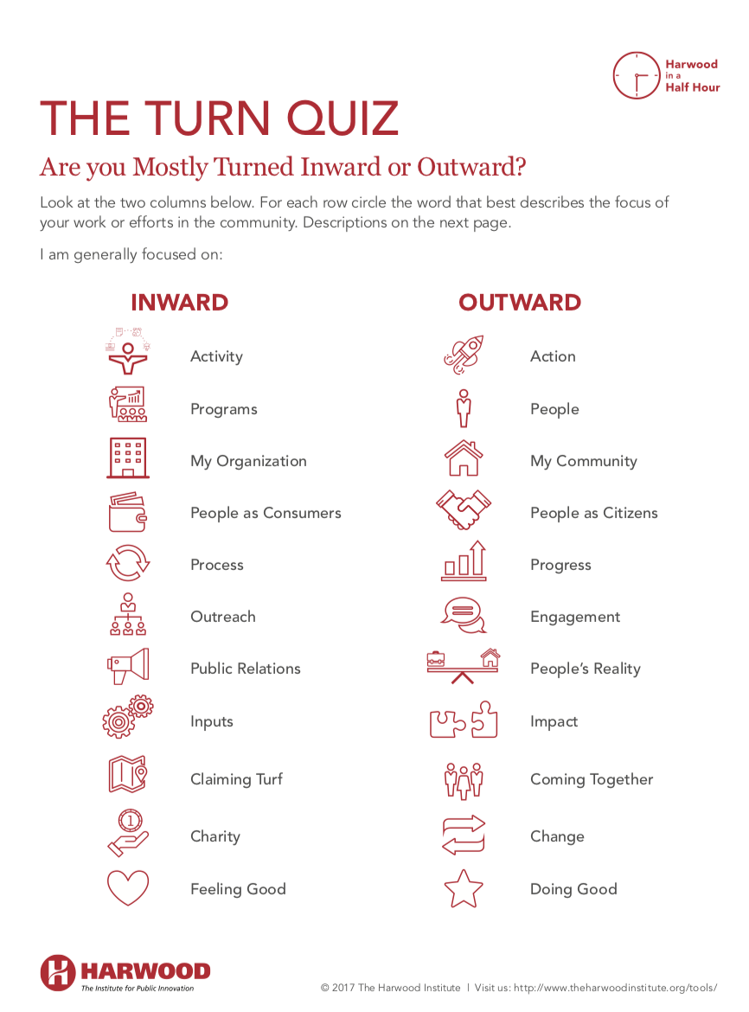
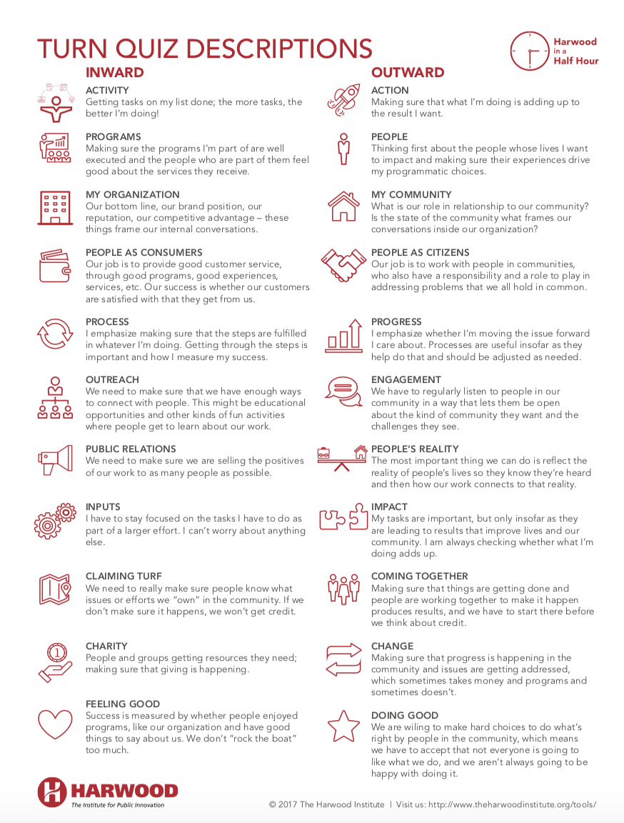

Slide 7
Questions for your small table
What do you make of your results?
What Turning Outward “score” would people in your community give your library?
What do you think Turning Outward is?
What are the implications of being Turned Outward?
  From library perspective
  From community perspective

Slide 8
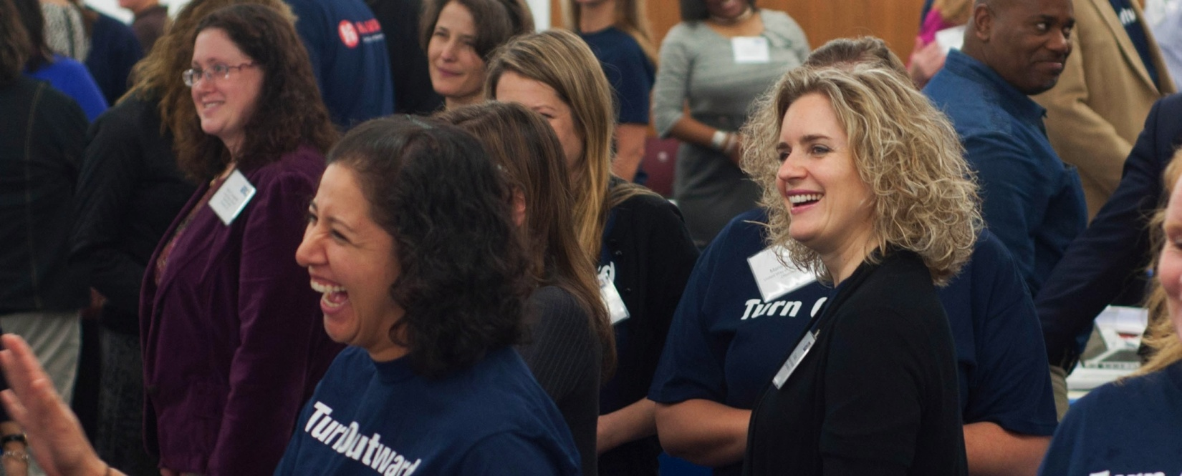
Turning Outward
An orientation toward community –
literally about the direction we are facing!
Without it, there is little chance for change.
8

Slide 9
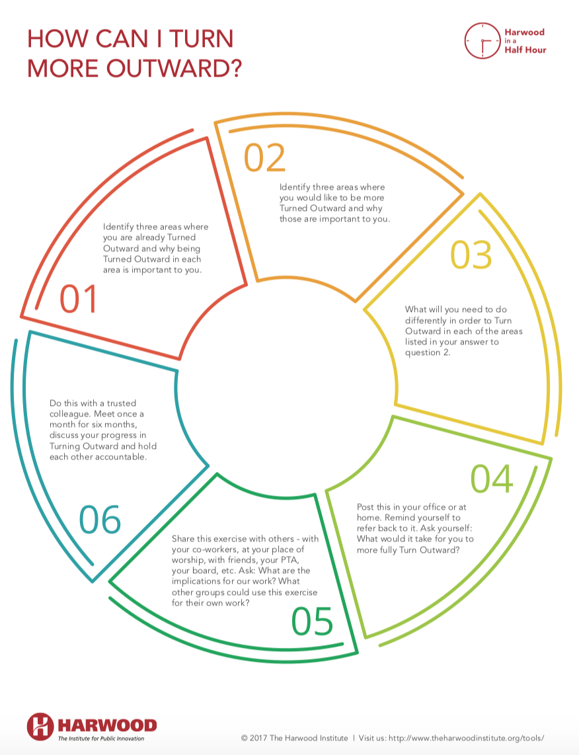
Benefits + How to Use at Home
Repositioning libraries and library professionals as conveners and facilitators of community innovation and change
Bringing new tools, skill development and learning opportunities that support enhanced capacity for community engagement
Demonstrated results in communities to increase their ability to work effectively together on issues the community cares about

Slide 10
Mindset… Operating Framework... Practice and Tools
Being Turned Outward
Implementation and Innovation Cycles
Understanding Community
Creating Conditions for Change and Sustainability
Deciding on the Right Path
Next Virtual
Public Innovator Labs
Apr 5 – May 24
Sept 27 – Nov 15
10

Slide 11
Resources Online
Tools, videos, books
https://theharwoodinstitute.org
Library-specific case studies
http://www.ala.org/tools/librariestransform/libraries-transforming-communities/case-studies
(Search: ALA Libraries Transforming Communities)

Slide 12
CONTACT
Cheryl Gorman cgorman@theharwoodinstitute.org
Susan Taylor Simpson
staylorsimpson@theharwoodinstitute.org

